Slide 1
ZoneAlarm.com
Brandon Davies
Nathan Nickel

Slide 2
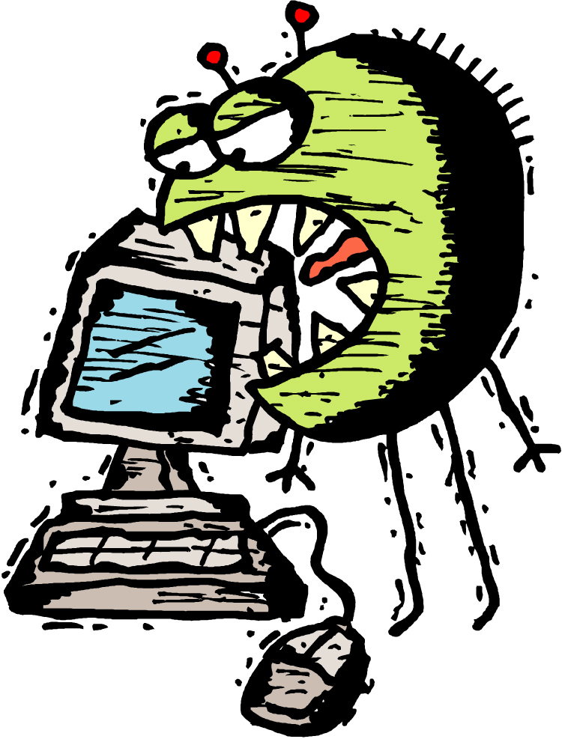
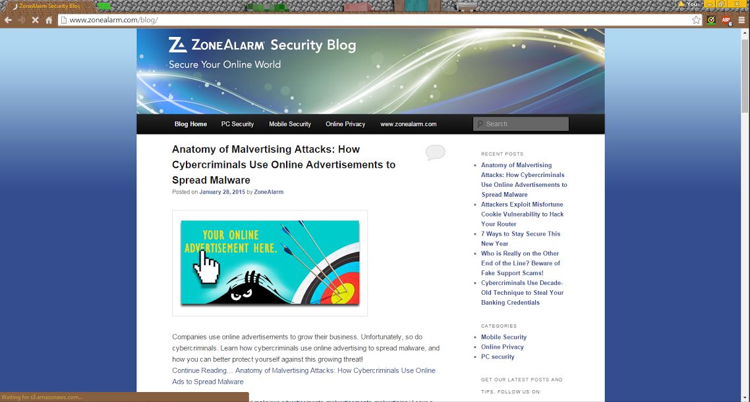
ZoneAlarm security blog
anti virus
security tips
blog
http://www.zonealarm.com/blog/
Notes:
Zonealarm is a online antivirus and security software

Slide 3
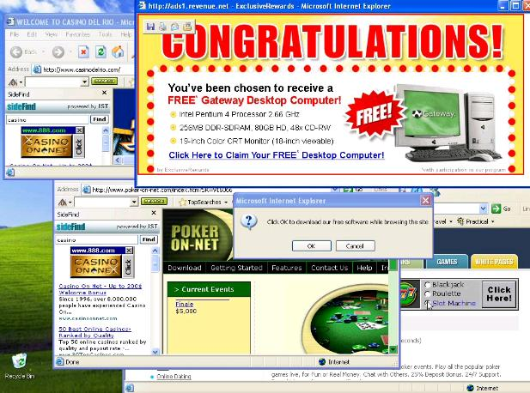
How Cybercriminals use Online Advertisements to Spread Malware
Increased >200% in 2013
Created by:
Hack website and infect legitimate ads
Create legitimate ad and then change link
Malware can look like:
Fake Infection/Update Warning
Malware can be:
Spyware
Ransom

Slide 4
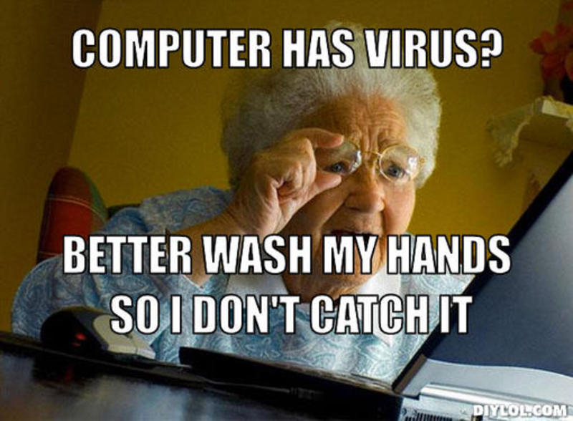
How Cybercriminals use Online Advertisements to Spread Malware Con’t
Defence:
Antivirus/Firewall
AdBlock
OS Updates
Beware fake updates

Slide 5
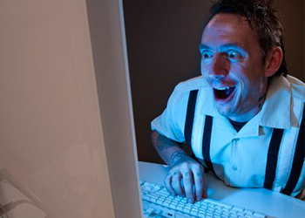
Attackers Exploit Misfortune Cookie Vulnerability to Hack Your Router
monitor internet use
what can you do?
secure you PC
HTTPS
router firmware
Notes:
steal your credentials and personal data, infect your machines with malware, and even control the devices on your network.

Slide 6
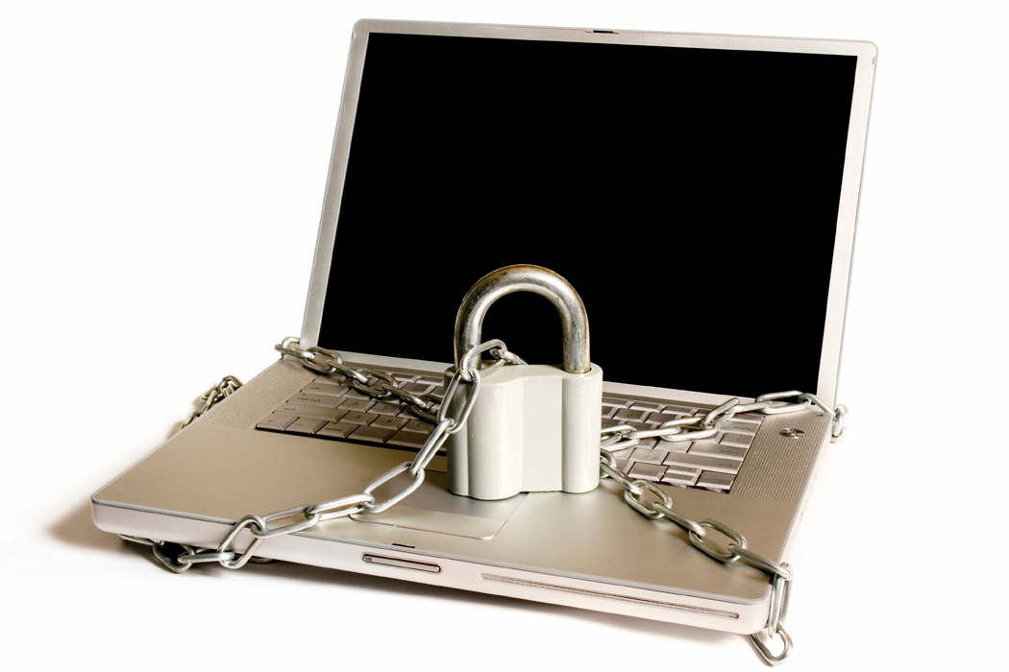
7 Ways to Stay Secure This New Year
Firewall / Antivirus
Updates
Strong Passwords
Two-factor Authentication
Avoid Email Link Login
Avoid Sensitive Accounts on Public WiFi
Secure Home Wireless Router (no WEP)

Slide 7
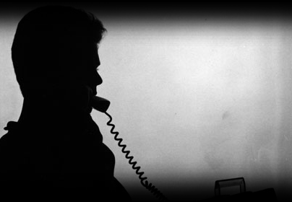
Who is Really on the Other End of the Line? Fake Support Scams!
scare tactics
ID
Windows event log
what do they do
credit card
malware

Slide 8
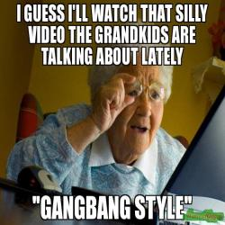
Who is Really on the Other End of the Line? Fake Support Scams!
what can you do
remote access
credit card company
back up
inform vulnerable people

Slide 9
Decade-Old Technique to Steal Your Banking Credentials
The virus Didrex is distributed through email attachments
Uses macro functions from MS Word or Excel
Waits for banking logon and adds to ask for additional credentials

Slide 10
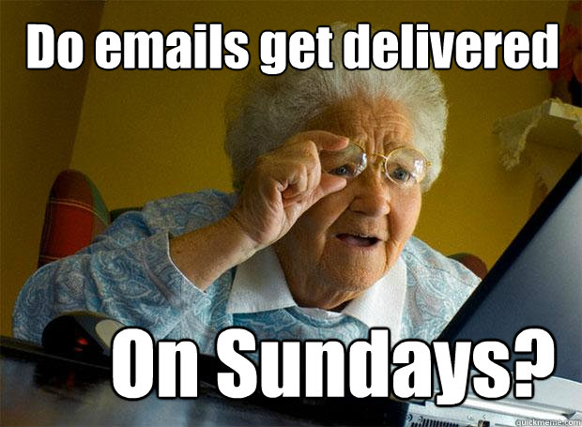
Decade-Old Technique to Steal Your Banking Credentials
You Should
Lean to spot spam
Be cautious of MS macro functions
Protect PC with antivirus

Slide 11
ZoneAlarm Bias
ZoneAlarm is an Antivirus Company
Bias Towards Selling Antivirus
Each blog is about an issue that can be fixed with antivirus
Step one is ussually buying an antivirus

Slide 12
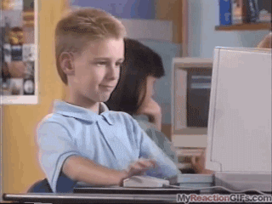
Synopsis
ZoneAlarm
Malicious ads
Router
Telephone scams
Firewall / Antivirus
Updates
Bias Towards Selling Antivirus

Slide 13

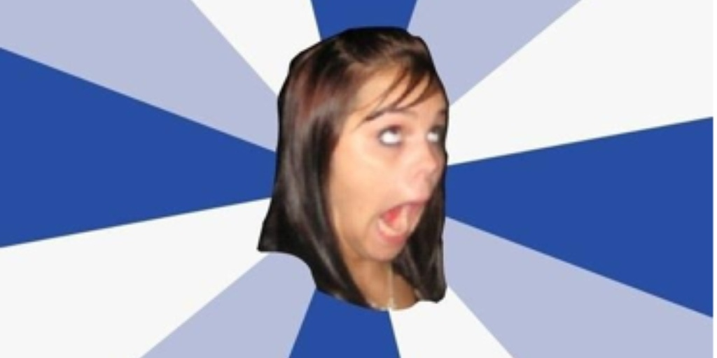
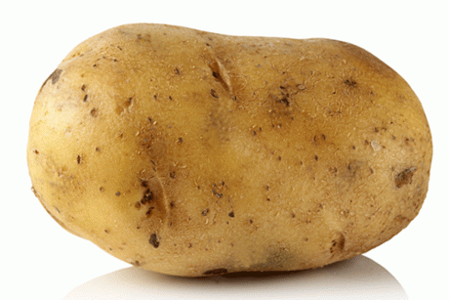
420 whoo 360-no-scope, mountain dew MLG 69 #yolo #hashtag #no filter #no make up #bootylishous #sawg
10/10 would watch again-ign
g+ FTW

